Slide 1


http://www.comp.nus.edu.sg/~cs1010/
UNIT 4
Top-Down Design & Functions

Slide 2

PROGRAMMING METHODOLOGY (PHƯƠNG PHÁP LẬP TRÌNH)
UNIT 4: Top-Down Design & Functions

Slide 3
Acknowledgement
The contents of these slides have origin from School of Computing, National University of Singapore.
We greatly appreciate support from Mr. Aaron Tan Tuck Choy for kindly sharing these materials.

Slide 4
Policies for students
These contents are only used for students PERSONALLY.
Students are NOT allowed to modify or deliver these contents to anywhere or anyone for any purpose.

Slide 5
Recording of modifications
Currently, there are no modification on these contents.

Slide 6
Unit 4: Top-Down Design & Functions
Objectives:
How to analyse, design, and implement a program
How to break a problem into sub-problems with step-wise refinement
How to create your own user-defined functions
Reference:
Chapter 5 Functions: Lessons 5.1 – 5.3

Slide 7
Unit 4: Top-Down Design & Functions (1/2)
Problem Solving
Case Study: Top-Down Design
Computing the weight of a batch of flat washers
Incremental Refinement (some hierarchical chart)
Top-down design (of program) with structure charts
Function Prototypes
Default Return Type
‘return’ statement in main()

Slide 8
Unit 4: Top-Down Design & Functions (2/2)
Writing Functions
Exercise #1: A Simple “Drawing” Program
Pass-By-Value and Scope Rules
Global Variables

Slide 9
Problem Solving (1/2)
Determine problem features
Analysis
Iterative process
Write algorithm
Design
Produce code
Implementation
Check for correctness and efficiency
Testing

Slide 10
Problem Solving (2/2)
Analysis and Design
stepwise
refinement
NO
(hierarchy of)
sub-problems
Can sub-problems
be implemented?
YES
structure chart
Implementation
& Testing
Zoom Shape 1
Zoom Shape 2
Zoom Shape 3
Knowledge in C
and its libraries
Knowledge in
data structure
(mostly CS1020)
Knowledge in
algorithms

Slide 11
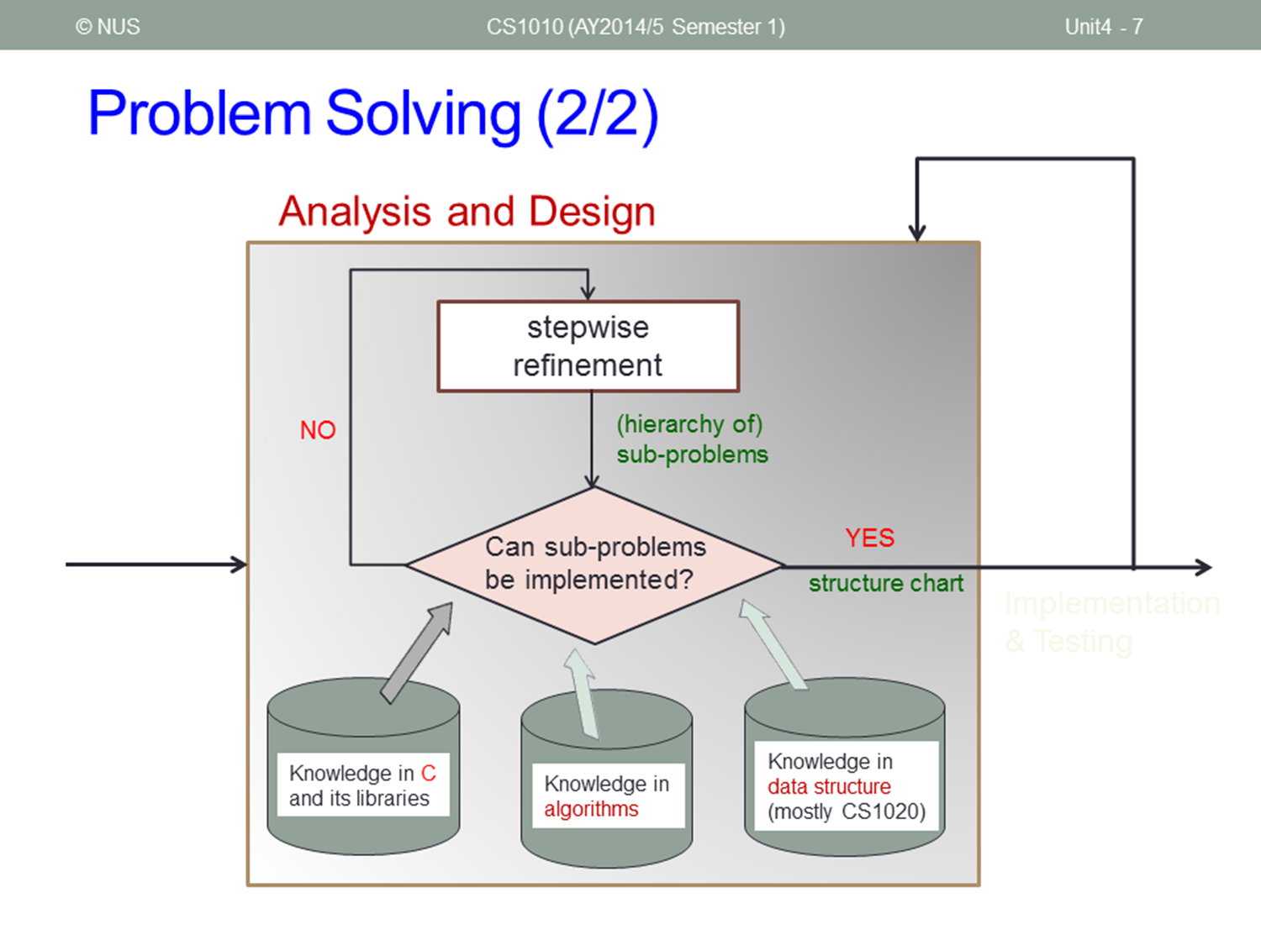

Problem Solving (2/2)
Analysis and Design
stepwise
refinement
NO
(hierarchy of)
sub-problems
Can sub-problems
be implemented?
YES
structure chart
Implementation
& Testing
Knowledge in C
and its libraries
Knowledge in
data structure
(mostly CS1020)
Knowledge in
algorithms

Slide 12
Top-Down Design (1/13)
We introduced some math functions in the previous unit.
Such functions provide code reusability. Once the function is defined, we can use it whenever we need it, and as often as we need it.
These math functions are provided in <math.h>. What if we want to define our own functions and use them?
In the following case study, we introduce top-down design in approaching an algorithm problem.
In the process, we encounter certain tasks that are similar, hence necessitating the creation of user-defined function.

Slide 13
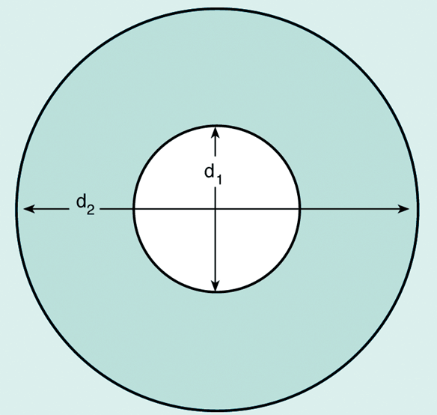
Top-Down Design (2/13)
Case Study: You work for a hardware company that manufactures flat washers. To estimate shipping costs, your company needs a program that computes the weight of a specified quantity of flat washers.
rim area = π(d₂/2)² – π(d₁/2)²

Slide 14
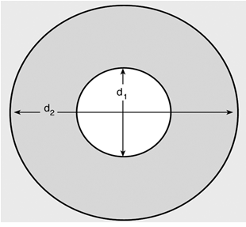
Top-Down Design (3/13)
Analysis:
To get the weight of a specified qty of washers, we need to know the weight of each washer
To get the weight of a washer, we need its volume and density (weight = volume × density)
To get the volume, we need its rim area and thickness (volume = rim area × thickness)
To get the rim area, we need the diameters d2 and d1
Total weight
rim area = π(d₂/2)² – π(d₁/2)²
qty
weight
qty, density, thickness, d2 and d1 are given as inputs
volume
density
rim area
thickness
d2
d1

Slide 15
Top-Down Design (4/13)
Design (pseudocode):
Read inputs (qty, density, thickness, d2, d1)
Compute weight of one washer
2.1 Compute area of small circle (hole) using d1
2.2 Compute area of big circle using d2
2.3 Subtract small area from big area to get rim area
2.4 Compute volume = rim area × thickness
2.5 Compute weight = volume × density
Compute total weight of specified number of washer = weight × qty
Output the calculated total weight
Total weight
qty
weight
volume
density
rim area
thickness
d2
d1
Step-wise refinement: Splitting a complex task (step 2) into subtasks (steps 2.1 – 2.5)

Slide 16
Top-Down Design (5/13)
Design (hierarchical chart):
Compute Total Weight
Ask for all inputs
qty?
density?
thickness?
d1?
d2?
Compute Weight
Compute hole area (use d1)
Compute big circle area (use d2)
Compute rim area
Compute volume (use thickness)
Compute weight (use density)
Compute weight x qty
Output total weight
Note that the computation of area (which employs the same formula) is performed twice.

Slide 17
Top-Down Design (6/13)
Design (structure chart):
A documentation tool that shows the relationship among the sub-tasks
Compute Total Weight
Input : qty, density, thickness, d1, d2
Compute Weight of a single washer
Compute circle area
Compute total Weight
Output total weight
This is called twice.

Slide 18
Top-Down Design (7/13)
#include <stdio.h>
#include <math.h>
#define PI 3.14159
int main(void) {
double d1, // hole circle diameter
d2, // big circle diameter
thickness,
density;
int qty;
double unit_weight, // single washer's weight
total_weight, // a batch of washers' total weight
outer_area, // area of big circle
inner_area, // area of small circle
rim_area; // single washer's rim area
// read input data
printf("Inner diameter in cm: "); scanf("%lf", &d1);
printf("Outer diameter in cm: "); scanf("%lf", &d2);
printf("Thickness in cm: "); scanf("%lf", &thickness);
printf("Density in grams per cubic cm: "); scanf("%lf", &density);
printf("Quantity: "); scanf("%d", &qty);
Unit4_Washers.c
// compute weight of a single washer
outer_area = pow(d2/2, 2) * PI;
inner_area = pow(d1/2, 2) * PI;
rim_area = outer_area - inner_area;
unit_weight = rim_area * thickness * density;
// compute weight of a batch of washers
total_weight = unit_weight * qty;
// output
printf("Total weight of the batch of %d washers is %.2f grams.\n",
qty, total_weight);
return 0;
}

Slide 19
Top-Down Design (8/13)
Unit4_Washers.c
// compute weight of a single washer
outer_area = pow(d2/2, 2) * PI;
inner_area = pow(d1/2, 2) * PI;
rim_area = outer_area - inner_area;
unit_weight = rim_area * thickness * density;
// compute weight of a batch of washers
total_weight = unit_weight * qty;
// output
printf("Total weight of the batch of %d washers is %.2f grams.\n",
qty, total_weight);
return 0;
}
gcc -Wall Unit4_Washers.c -lm

Slide 20
Top-Down Design (9/13)
Note that area of circle is computed twice. For code reusability, it is better to define a function to compute area of a circle.
double circle_area(double diameter) {
return pow(diameter/2, 2) * PI;
}
We can then call/invoke this function whenever we need it.
circle_area(d2) 🡪 to compute area of circle with diameter d2
circle_area(d1) 🡪 to compute area of circle with diameter d1

Slide 21
Top-Down Design (10/13)
#include <stdio.h>
#include <math.h>
#define PI 3.14159
double circle_area(double diameter) {
return pow(diameter/2, 2) * PI;
}
int main(void) {
// identical portion omitted for brevity
// compute weight of a single washer
rim_area = circle_area(d2) - circle_area(d1);
unit_weight = rim_area * thickness * density;
// identical portion omitted for brevity
}
Function definition
Calling circle_area() twice.

Slide 22
Top-Down Design (11/13)
Components of a function definition
Header (or signature): consists of return type, function name, and a list of parameters (with their types) separated by commas
Function names follow identifier rules (just like variable names)
May consist of letters, digit characters, or underscore, but cannot begin with a digit character
Return type is void if function does not need to return any value
Function body: code to perform the task; contains a return statement if return type is not void
Return type
Function name
Parameter
double circle_area(double diameter) {
return pow(diameter/2, 2) * PI;
}
Function body

Slide 23
Top-Down Design (12/13)
double circle_area(double diameter) {
return pow(diameter/2, 2) * PI;
}
Values of arguments are copied into parameters
rim_area = circle_area(d2) - circle_area(d1);
Value of d2 copied to parameter diameter
Value of d1 copied to parameter diameter
Arguments need not be variable names; they can be constant values or expressions
circle_area(12.3) 🡪 To compute area of circle with diameter 12.3
circle_area((a+b)/2) 🡪 To compute area of circle with diameter (a+b)/2, where a and b are variables

Slide 24
Top-Down Design (13/13)
Preferred practice: add function prototype
Before main() function
Parameter names may be omitted, but not their type
Unit4_WashersV2.c
#include <stdio.h>
#include <math.h>
#define PI 3.14159
double circle_area(double);
int main(void) {
// identical portion omitted for brevity
// compute weight of a single washer
rim_area = circle_area(d2) - circle_area(d1);
unit_weight = rim_area * thickness * density;
// identical portion omitted for brevity
}
double circle_area(double diameter) {
return pow(diameter/2, 2) * PI;
}
Function prototype
Line 32 (see slide 21)
Line 45 (see slide 21)
Function definition

Slide 25
Function Prototypes (1/2)
It is a good practice to put function prototypes at the top of the program, before the main() function, to inform the compiler of the functions that your program may use and their return types and parameter types.
Function definitions to follow after the main() function.
Without function prototypes, you will get error/warning messages from the compiler.

Slide 26
Function Prototypes (2/2)
Let’s remove (or comment off) the function prototype for circle_area() in Unit4_WashersV2.c
Messages from compiler:
Unit4_WashersV2.c: In function ‘main’:
Unit4_WashersV2.c:32:5: warning: implicit declaration of function ‘circle_area’
Unit4_WashersV2.c: At top level:
Unit4_WashersV2.c:45:8: error: conflicting types for ‘circle-area’
Unit4_WashersV2.c:32:16: previous implicit declaration of ‘circle_area’ was here
Without function prototype, compiler assumes the default (implicit) return type of int for circle_area() when the function is used in line 32, which conflicts with the function header of circle_area() when the compiler encounters the function definition later in line 45.

Slide 27
Default Return Type (1/3)
A ‘type-less’ function has default return type of int
1 #include <stdio.h>
2
3 int main(void) {
4 printf("%d\n", f(100, 7));
5 return 0;
6 }
7
8 f(int a, int b) {
9 return a*b*b;
10 }
Program can be compiled, but with warning:
warning: implicit declaration of function 'f' 🡨 line 4 (due to absence of function prototype)
warning: return type defaults to 'int' 🡨 line 8

Slide 28
Default Return Type (2/3)
Another example
1 #include <stdio.h>
2
3 int main(void) {
4 f(100, 7);
5 return 0;
6 }
7
8 void f(int a, int b) {
9 return a*b*b;
10 }
Without function prototype, compiler assumes function f to be an int function when it encounters this.
However, f is defined as a void function here, so it conflicts with above.
Program can be compiled, but with warning:
warning: implicit declaration of function 'f' 🡨 line 4 (due to absence of function prototype)
warning: conflicting types for 'f' 🡨 line 8

Slide 29
Default Return Type (3/3)
Tips
Provide function prototypes for all functions
Explicitly specify the function return type for all functions
1 #include <stdio.h>
2
3 int f(int, int);
4
5 int main(void) {
6 printf("%d\n", f(100, 7));
7 return 0;
8 }
9
10 int f(int a, int b) {
11 return a*b*b;
12 }

Slide 30
‘return’ statement in main()
Q: Why do we write return 0; in our main() function?
Answer:
Our main() function has this header
int main(void)
Hence it must return an integer (to the operating system)
The value 0 is chosen to be returned to the operating system (which is UNIX in our case). This is called the status code of the program.
In UNIX, when a program terminates with a status code of 0, it means a successful run.
You may optionally check the status code to determine the appropriate follow-up action. In UNIX, this is done by typing echo $? immediately after you have run your program. – You do not need to worry about this.

Slide 31
Writing Functions (1/5)
A program is a collection of functions (modules) to transform inputs to outputs
In general, each box in a structure chart is a sub-problem which is handled by a function
In mathematics, a function maps some input values to a single (possibly multiple dimensions) output
In C, a function maps some input values to zero or more output values
No output: void func(…) { … }
One output, e.g., double func(…) { …; return value; }
More outputs through changing input values (we’ll cover this later)
Return value (if any) from function call can (but need not) be assigned to a variable.

Slide 32
Writing Functions (2/5)
Syntax:
function interface comment
ftype fname (formal parameters list)
{
local variable declarations
executable statements
return statement (if appropriate)
}
Unit4_FunctionEg.c
/*
* Finds the square root of the
* sum of the squares of the two parameters
* Precond: x and y are non-negative numbers
*/
double sqrt_sum_square(double x, double y) {
// x and y above are the formal parameters
double sum_square; // local variable declaration
sum_square = pow(x,2) + pow(y,2);
return sqrt(sum_square);
}
Notes:
Precondition: describes conditions that should be true before calling function.
Postcondition: describes conditions that should be true after executing function.
These are for documentation purpose.

Slide 33
Writing Functions (3/5)
Actual parameters (also arguments) are values passed to function for computation
Formal parameters (or simply parameters) are placeholder when function is defined.
Matching of actual and formal parameters from left to right
Scope of formal parameters, local variables are within the function only
int main(void) {
double y = 1.23; // not the same as y
// in sqrt_sum_square
double z = 4.56;
// x below not the same as x in sqrt_sum_square
double x = sqrt_sum_square(y, z);
printf("The square root of the sum of square ");
printf("of %.2f and %.2f is %.2f\n", y, z, x);
return 0;
}
// Function prototype at top of program
double sqrt_sum_square(double, double);
double sqrt_sum_square(double x, double y)
{
// x and y above are formal parameters
double sum_square; // local variable
sum_square = pow(x,2) + pow(y,2);
return sqrt(sum_square);
}
Arrows indicate flow of control between main() and the function
Add function prototype at top of program, before main() function

Slide 34
Writing Functions (4/5)
Unit4_FunctionEg.c
#include <stdio.h>
#include <math.h>
/* Function prototype placed at top of program */
double sqrt_sum_square(double, double);
int main(void) {
double y = 1.23; // not the same as y in sqrt_sum_square
double z = 4.56;
// x below has nothing to do with x in sqrt_sum_square
double x = sqrt_sum_square( y, z );
// in the previous statement, y and z are actual parameters
printf("The square root of the sum of squares ");
printf("of %.2f and %.2f is %.2f\n", y, z, x);
return 0;
}
/* Finds the square root of the
* sum of the squares of the two parameters
* Precond: x and y are non-negative numbers
*/
double sqrt_sum_square(double x, double y) {
// x and y above are the formal parameters
double sum_square; // local variable declaration
sum_square = pow(x,2) + pow(y,2);
return sqrt(sum_square);
}
The complete program

Slide 35
Writing Functions (5/5)
Use of functions allow us to manage a complex (abstract) task with a number of simple (specific) ones.
This allows us to switch between abstract and go to specific at ease to eventually solve the problem.
Function allows a team of programmers working together on a large program – each programmer will be responsible for a particular set of functions.
Function is good mechanism to allow re-use across different programs. Programmers use functions like building blocks.
Function allows incremental implementation and testing (with the use of driver function to call the function and then to check the output)
Acronym NOT summarizes the requirements for argument list correspondence. (N: number of arguments, O: order, and T: type).

Slide 36



Ex #1: A Simple “Drawing” Program (1/3)
Problem:
Write a program Unit4_DrawFigures.c to draw a rocket ship (which is a triangle over a rectangle over an inverted V), a male stick figure (a circle over a rectangle over an inverted V), and a female stick figure (a circle over a triangle over an inverted V)
rocket
male
female
Analysis:
No particular input needed, just draw the needed 3 figures
There are common shapes shared by the 3 figures
Design:
Algorithm (in words):
Draw Rocket ship
Draw Male stick figure (below Rocket ship)
Draw Female stick figure (below Male stick figure)

Slide 37
Ex #1: A Simple “Drawing” Program (2/3)
Design (Structure Chart):
Draw 3 Figures
Draw Rocket Ship
Draw Triangle
Draw Rectangle
Draw Inverted V
Draw Male Stick Figure
Draw Circle
Draw Rectangle
Draw Inverted V
Draw Female Stick Figure
Draw Circle
Draw Triangle
Draw Inverted V
rocket
male
female

Slide 38
Ex #1: A Simple “Drawing” Program (3/3)
Implementation (partial program)
Unit4_DrawFiguresPartial.c
#include <stdio.h>
void draw_rocket_ship();
void draw_male_stick_figure();
void draw_circle();
void draw_rectangle();
int main(void) {
draw_rocket_ship();
printf("\n\n");
draw_male_stick_figure();
printf("\n\n");
return 0;
}
void draw_rocket_ship() {
}
void draw_male_stick_figure() {
}
void draw_circle() {
printf(" ** \n");
printf(" * * \n");
printf(" * * \n");
printf(" ** \n");
}
void draw_rectangle() {
printf(" ****** \n");
printf(" * * \n");
printf(" * * \n");
printf(" * * \n");
printf(" ****** \n");
}
Write a complete program Unit4_DrawFigures.c

Slide 39
Pass-By-Value and Scope Rules (1/4)
In C, the actual parameters are passed to the formal parameters by a mechanism known as pass-by-value.
a
b
int main(void) {
double a = 10.5, b = 7.8;
printf("%.2f\n", srqt_sum_square(3.2, 12/5);
printf("%.2f\n", srqt_sum_square(a, a+b);
return 0;
}
10.5
7.8
Actual parameters:
10.5 and 18.3
3.2 and 2.0
double sqrt_sum_square(double x, double y) {
double sum_square;
sum_square = pow(x,2) + pow(y,2);
return sqrt(sum_square);
}
Formal parameters:
x
y
10.5
18.3
3.2
2.0

Slide 40
Pass-By-Value and Scope Rules (2/4)
Formal parameters are local to the function they are declared in.
Variables declared within the function are also local to the function.
Local parameters and variables are only accessible in the function they are declared – scope rule.
When a function is called, an activation record is created in the call stack, and memory is allocated for the local parameters and variables of the function.
Once the function is done, the activation record is removed, and memory allocated for the local parameters and variables is released.
Hence, local parameters and variables of a function exist in memory only during the execution of the function. They are called automatic variables.
In contrast, static variables exist in the memory even after the function is executed. (We will not use static variables in CS1010.)

Slide 41
Pass-By-Value and Scope Rules (3/4)
Spot the error in this code:
int f(int);
int main(void) {
int a;
...
}
int f(int x) {
return a + x;
}
Answer:
Variable a is local to main(), not f(). Hence, variable a cannot be used in f().

Slide 42
Pass-By-Value and Scope Rules (4/4)
Trace this code by hand and write out its output.
In main, before: a=2, b=3
In g, before: a=2, b=3
#include <stdio.h>
void g(int, int);
int main(void) {
int a = 2, b = 3;
printf("In main, before: a=%d, b=%d\n", a, b);
g(a, b);
printf("In main, after : a=%d, b=%d\n", a, b); return 0;
}
void g(int a, int b) {
printf("In g, before: a=%d, b=%d\n", a, b);
a = 100 + a;
b = 200 + b;
printf("In g, after : a=%d, b=%d\n", a, b);
}
In g, after : a=102, b=203
In main, after : a=2, b=3

Slide 43
Global Variables (1/2)
Global variables are those that are declared outside all functions.
int f1(int);
void f2(double);
int glob; // global variable
int main(void) {
...
glob = glob + 1;
}
int f1(int x) {
...
glob = glob + 1;
}
void f2(double x) {
...
glob = glob + 1;
}

Slide 44
Global Variables (2/2)
Global variables can be accessed and modified by any function!
Because of this, it is hard to trace when and where the global variables are modified.
Hence, we will NOT allow the use of global variables

Slide 45
Summary
In this unit, you have learned about
Top-down design through stepwise refinement, splitting a task into smaller sub-tasks
How to write user-defined functions and use them
Pass-by-value and scope rules of local parameters and variables

Slide 46
End of File

Slide 47


